Slide 1
WELCOME TO ALL

Slide 2
ONLINE MARKSHEET GENERATION SYSTEM
Submitted by
T.MANGAYARKARASI
(REGNO: 19626ER015)
Guided by
Mrs. C. KAVITHA M.Sc., M.Phil., (PhD).

Slide 3
ABSTRACT
In the digital India this system becomes a relatively easier process for the colleges to generate and store all mark sheet records.
My project based on student mark sheet generation that uses PHP language.
The Mark sheet Generator is flexible for generating and distributing progress mark sheet of students. Also, the system displays all the available records for students. In addition, the system allow students to fetch their mark sheets.
To simply put, this system is to provide the mark-sheet for credit based grading system in user friendly and secure manner.
My project based on student mark sheet generation that uses PHP language and I used MySQL to store the data.
My project aims at developing a mark sheet generation system which can be used in schools, colleges, universities, to automate the distribution of digitally verifiable student mark sheets.

Slide 4
INTRODUCTION
The Mark sheet Generator is flexible for generating and distributing mark sheet of students.
My project is divided into two categories;
admin
student
In an overview of this web application, the student can get their respective mark sheets. For this, the student has to enter his/her register number and date of birth. After that, the system displays the mark sheet of that particular student.

Slide 5
SYSTEM SPECIFICATIONS
HARDWARE REQUIREMNETS
Processor : Intel(R) core(TM) i3
Processor Speed : 2.50 GHz
Ram : 2 GB
Hard Disk Drive : 160 GB
CD-ROM Drive : Sony
Monitor : “17” inches
Keyboard : TVS Gold
Mouse : Logitech

Slide 6
SOFTWARE REQUIREMENTS
Operating System : Windows 10
Technology Used : PHP, HTML
Database : MY – SQL
IDE Tool : Sublime Text
Database Connectivity : Native Connectivity
Web Server : Apache
Browser : Chrome

Slide 7
EXISTING SYSTEM
The existing system is based on manual system, which takes lot of time to get performance of the test. All this process only consumes time and requires huge manpower. Searching a particular data is also very tedious in this System.
In this system to get mark sheet the student have to approach their colleges directly and also they need to wait some more time in queue because of the administration proceed all the works in manually.
So there is a need to the system which can reduce these problems.
The existing system fails to provide a good user interface. Data redundancy is also complex in such a system. This may leads to the inconsistencies of data handling. DISADVANTAGES:
Existing system consumes huge manpower which includes calculations took a lot of time.
The maintenance cost of records and occurrence of transaction is expensive.
All the works needs to be done manually. Searching of a particular mark sheet is very complex.

Slide 8
PROPOSED SYSTEM
The main objective of the developed system is to keep in pace with the growth of the computerization. The University only needs to upload the exam records to the system and then the system will complete rest of the work.
The marksheet generator is to ensure an efficient certificate management using huge data and to provide mark-sheets for credit based grading system (CBGS) in very user friendly manner by not making it very complex.
The system being automated and generalized, the system ensures to reduce manual errors by reducing manual efforts. The technology is rapid and able to generate, store & display the mark-sheets of the students. The system provides advance reaction capabilities and automatic operator of the internal calculation based on university rules with the information from the database. It also works with various standards of the mark-sheets.
ADVANTAGES
The developed system will reduce the time to create the marks sheet of the student.
After the maklist records are entered by the admin the marksheet reports are generated automatically.
It is most reliable & time saving system while providing the mark sheet process.
It can create easy, friendly environment for administration to manage all student mark sheets.

Slide 9
MODULES
1.REGISTRATION
2.ADMIN
3.STUDENT

Slide 10
MODULE DESCRIPTION
REGISTRATION MODULE:
If the admin is operating the system they can access the system by providing their login id and password.
If the student is accessing the system they should provide their registration id and password. If the student does not have any account they can also create an account by registering their details.
ADMIN MODULE:
The admin can also access the system by updating the database, removing the unwanted data from the database and the admin can get the required information from the database.
The admin module actions are described in the following parts
USER DETAILS: In this part students basis information are included into the database such as user id, department id, student name, email id, password, reg.no, date of birth, department.
ADD SUBJECT: The admin of the system can add subject details in this module. This includes subject code, subject name, credit and department. That information will be stored in internal collection of information database and can be viewed in the table format.

Slide 11
ADD MARKS: In this module the admin can add marks for each subjects of the student. For this the admin needs to login into the account. Next the admin select the student from the student list form for whom admin wants to enter marks. The admin have to select the semester for which the admin wants to add marks by clicking the add marks button and then the admin can enter the marks for the particular semester he already selected.
This information will be stored in the database and can be view in the table format.
DOWNLOADED MARKSHEETS: The issued mark sheets list is show in this module to verify whether the particular student is got the mark sheet or not. It shows the mark sheet downloaded student’s name, course and department for verification.
STUDENT MODULE:
To view mark sheet the student first sign in their account. After providing their register number and date of birth for authentication process students are allowed to fetch their mark sheets. This, also allow the students to print their mark sheets.

Slide 12
CONCEPT
In this system input can be marks of the students of their theory exams, practical exams, internal assessment. Grades of student can be calculated according to rules, formulae and ordinances.
The formulae for calculation of CGP:
Cumulative Grade Performance (CGP):
An up to date of an overall performance of student from the time he/she enrolled in the university is obtained by calculating a number called cumulative grade performance index. It is calculated in similar manner of SGPI. CGPA is responsible to reflect final pass or fail status of student
CGPA =C1G1+C2G2+…………..+CnGn
C1+C2+………+Cn
CGPA=Sum of the multiplication of grade points by the credits of the courses
Sum of the credits of the courses in a semester

Slide 13
Conversion of Marks to Grade Points and Letter Grade
P – Pass
RA – Re-appear
AAA - Absent
RANGE OF MARKS | GRADE POINTS | LETTER GRADE | DESCRIPTION
90 – 100 | 9.0 – 10.0 | O | Outstanding
80 – 89 | 8.0 – 8.9 | D+ | Excellent
75 – 79 | 7.5 – 7.9 | D | Distinction
70 – 74 | 7.0 – 7.4 | A+ | Very Good
60 – 69 | 6.0 – 6.9 | A | Good
50 – 59 | 5.0 – 5.9 | B | Average
40 – 49 | 4.0 – 4.9 | C | Satisfactory
00 – 39 | 0.0 | U | Re-appear
ABSENT | 0.0 | AAA | ABSENT

Slide 14
IMPLEMENTATION
Step 1: If admin is operating the system, login id and password. If student is operating the system, they can access the system by providing the registration id.
Step 2: Check if provided login id and password or registration id is correct, if not go back to step 1 and if correct proceed for the step 3.
Step 3: If admin is operating the system, he can access the system by updating the database, changing the data in the database and can get the required information from the database. If students are operating the system, the can only view the mark sheet.
Step 4: It calculates the grade and grade point of each and every student as per the Credit based grading system (CBGS).
Step 5: Then this system will generate the mark sheet.
Step 6: Then this mark sheets are available to access to students by providing authentication. Students will get requested mark sheet in PDF for printing purpose.

Slide 15
SYSTEM DESIGN
DATABASE DESIGN
Users
Column | Type | Null | Default | Constraints
Id | int(11) | No |  | Primary Key
User_id | int(11) | No
Dept_id | int(11) | No
name | Varchar(50) | No
email | Varchar(50) | No
password | Varchar(40) | No
reg_no | Varchar(30) | No

Slide 16
DATABASE DESIGN
Users
Dob | Date | No
degree | Varchar(20) | No
department | Varchar(30) | No
certificate_no | Varchar(20) | No
status | tinyint (5) | No | 1
Df | tinyint(4) | No | 1
result_date | timestamp | No | CURRENT_TIMESTAMP
post_date | timestamp | No | CURRENT_TIMESTAMP

Slide 17
Subject
Column | Type | Null | Default | Constraints
Id | Int(11) | No |  | Primary Key
Dept_id | Int(11) | No
Sem | Int(15) | No
Sub_code | Varchar(30) | No
Subject | Varchar(100) | No
Credit | Int(11) | No
Status | Int(11) | No | 1
Post_date | Timestamp | No | CURRENT_TIMESTAMP

Slide 18
Student Marks
Column | Type | Null | Default | Constraints
Id | int(11) | No |  | Primary Key
Student_id | int(11) | No
Sub_id | int(11) | No
Dept_id | int(11) | No
Int_mark | int(100) | No
Ext_mark | int(100) | No
status | int(11) | No
Post_date | Timestamp | No | CURRENT_TIMESTAMP

Slide 19
DATA FLOW DIAGRAM
SYSTEM ARCHITECTURE
Collect Registration Information
Fill Information
Need more information
Internal Collection Information Database
Generate Marksheet
Marksheet
Marksheet via Internet

Slide 20
ADMIN LOGIN
Add Subject
Add Subject Form
Data store
Add marks
Student List
Login
Validate
Home Page
Logout
Display Add marks form
Select semester
Search student details
User
Data store
Marksheet Downloaded Report
Dispay students list

Slide 21
STUDENT LOGIN
Data Store
Get Details From Database
Validate
Generate Marksheet
Login
Validate
Home Page
Logout
Enter & Submit Reg.No , DOB
Print Marksheet

Slide 22
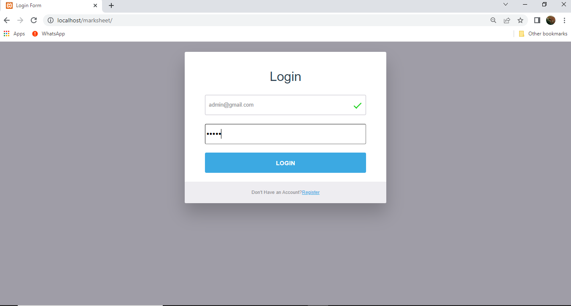
SAMPLE OUTPUT
Admin-Login

Slide 23
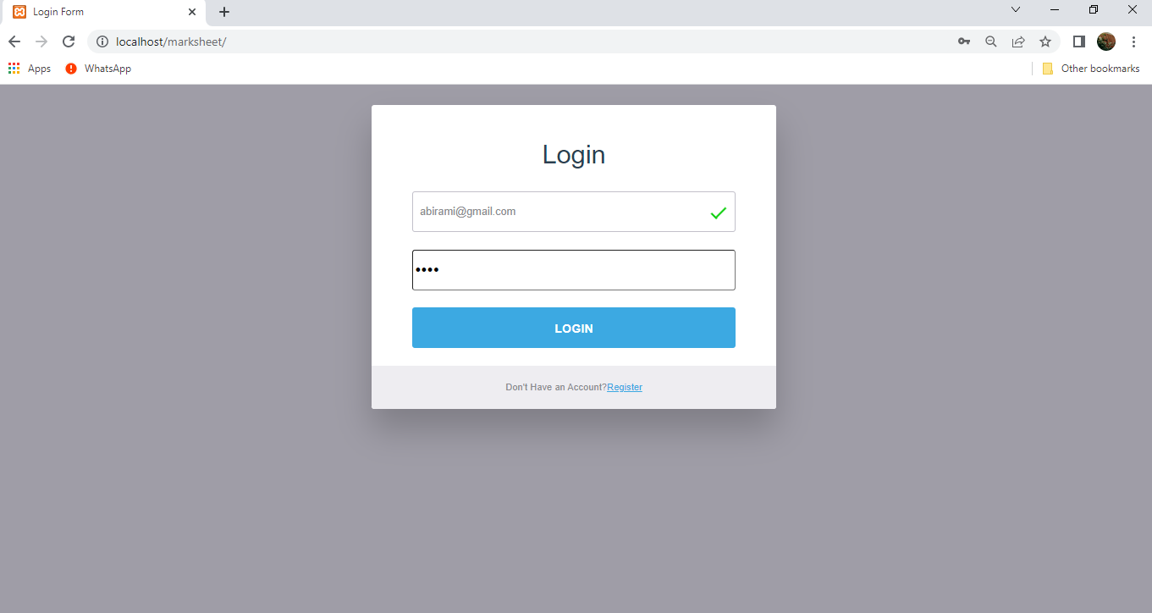
Student-Login

Slide 24
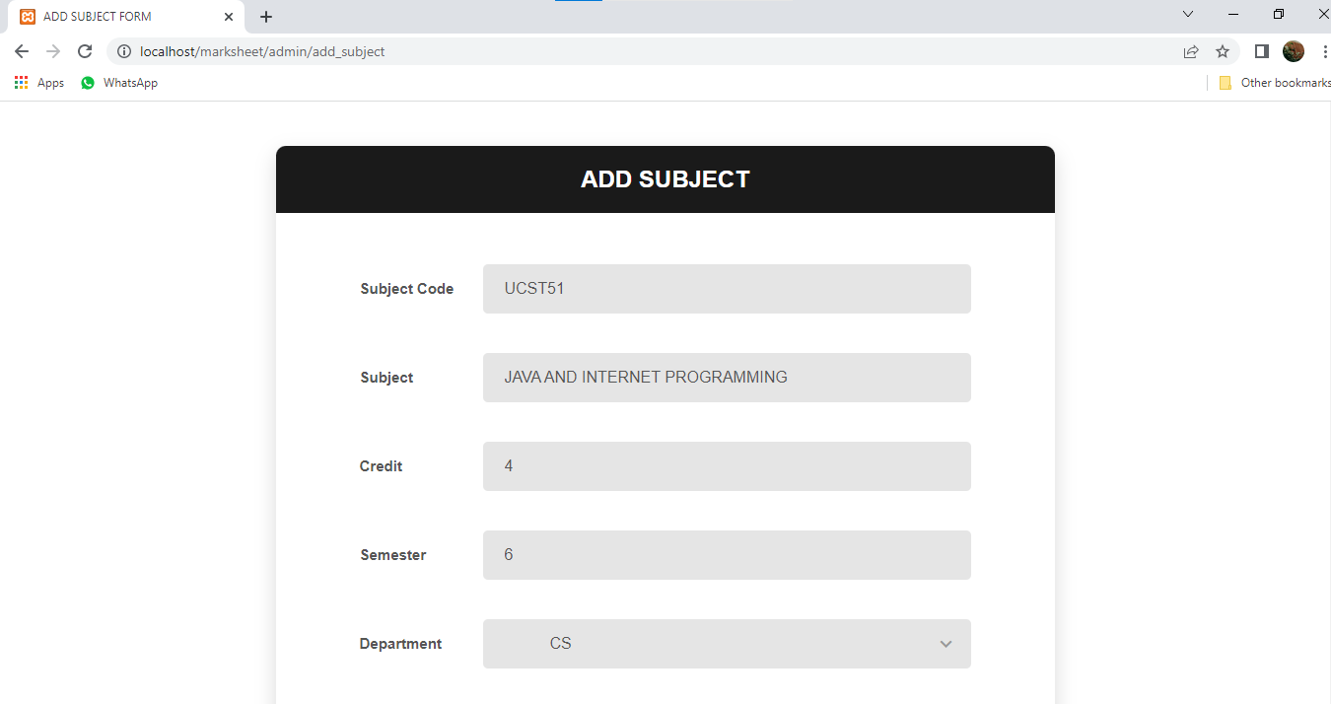
Add Subject

Slide 25
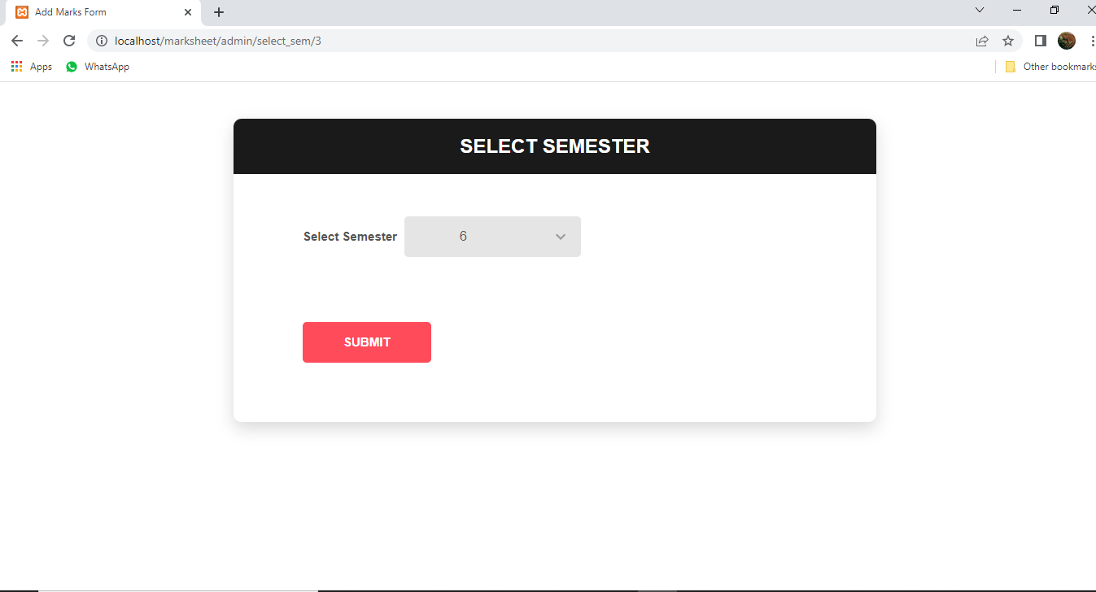
Semester Selection

Slide 26
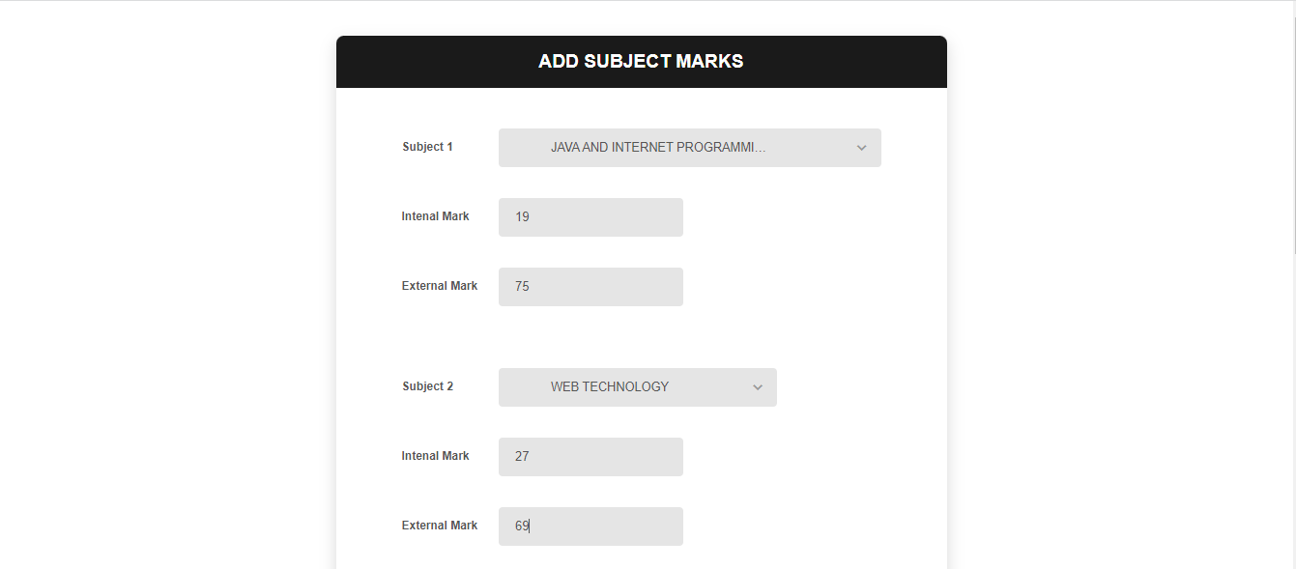
Add Marks

Slide 27
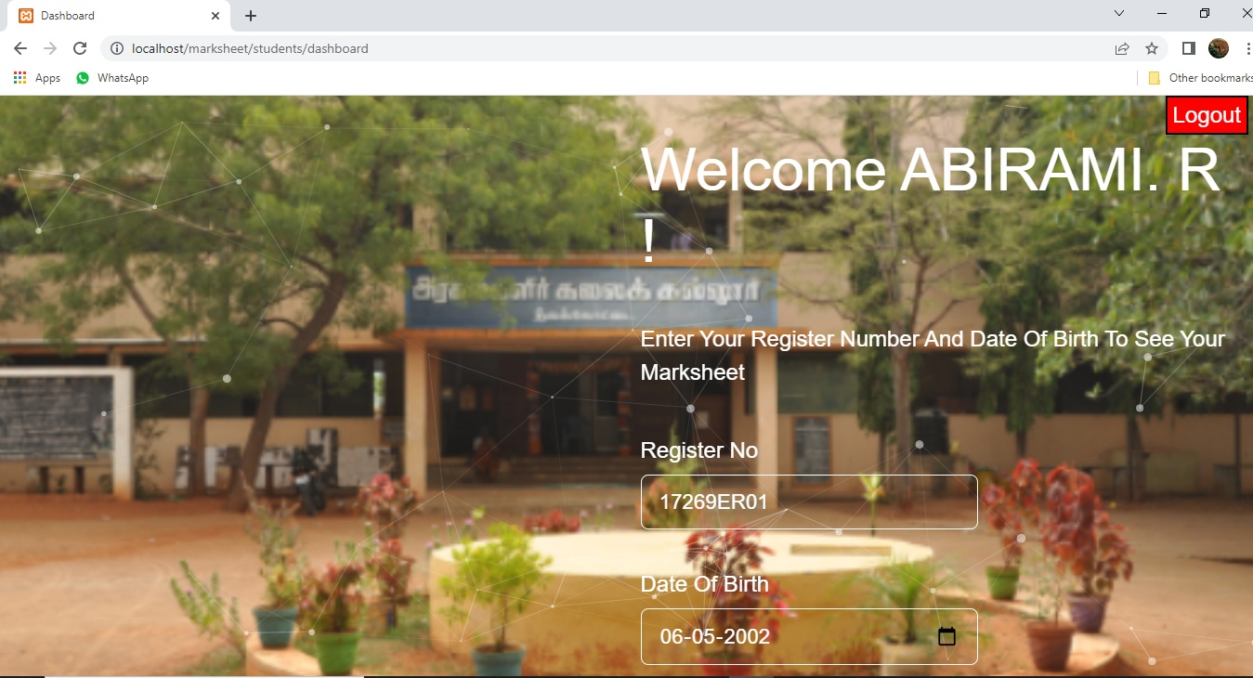
Student – Home Page

Slide 28
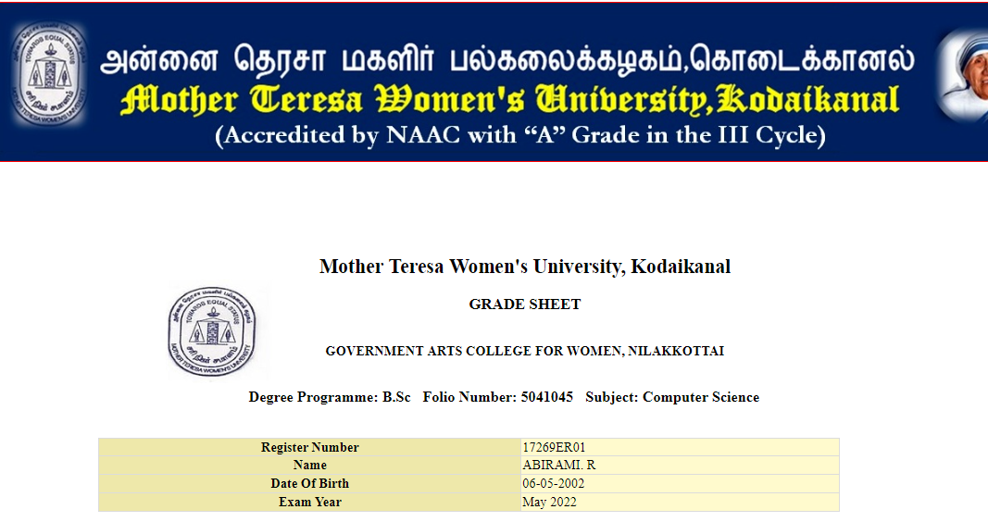
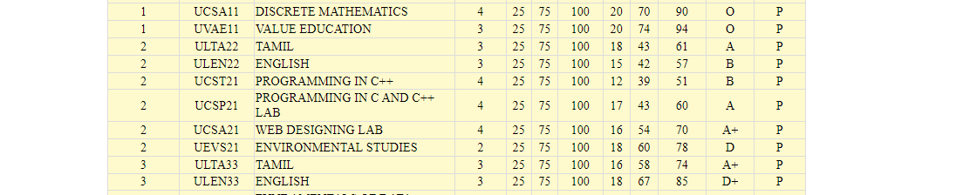
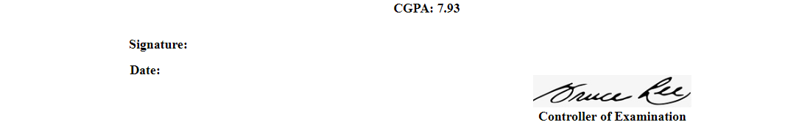
Mark sheet Result Page

Slide 29
CONCLUSION
Thus I have automated the examination system for generating the gadget sheet and marksheet of the student. I have completed the project with the entire module neatly and user friendly one. Thus this project will survive best among the users and provide them a best way to get marksheet through online.
I have completed the implementation and work of the following factors:
I have generated the mark sheet by automated fetching of marks of the students from database.
Generation of marksheet for individual student by fetching data from database and calculating the credits, grades, grade points, cumulative grade point and final result in terms of pass/fail.

Slide 30
FUTURE ENHANCEMENT
In order to meet the future needs, which can become progressively more complex the efficiency of the system can be improved by making some simple modifications in the programs.
In future the project will be altered by which the user is given more option to design.
This project can be updated in near future as and when requirement for the same arises, as it is very flexible in terms of expansion. This project has a very vast scope in future.
The software is flexible enough to be modified and implemented as per future requirements. The system can be made more secure by providing various security features at different levels.

Slide 31
THANK YOU

